Slide 1

Digital Image Processing
Lecture 1
Introduction & Fundamentals

Slide 2

Introduction
What is Digital Image Processing?
Digital Image
— a two-dimensional function
x and y are spatial coordinates
The amplitude of f is called intensity or gray level at the point (x, y)
Digital Image Processing
— process digital images by means of computer, it covers low-, mid-, and high-level processes
low-level: inputs and outputs are images
mid-level: outputs are attributes extracted from input images
high-level: an ensemble of recognition of individual objects
Pixel
— the elements of a digital image
Weeks 1 & 2

Slide 3
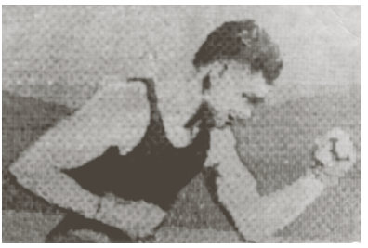
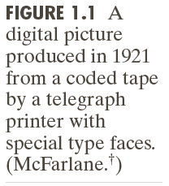
Origins of Digital Image Processing
Sent by submarine cable between London and New York, the transportation time was reduced to less than three hours from more than a week
Weeks 1 & 2

Slide 4
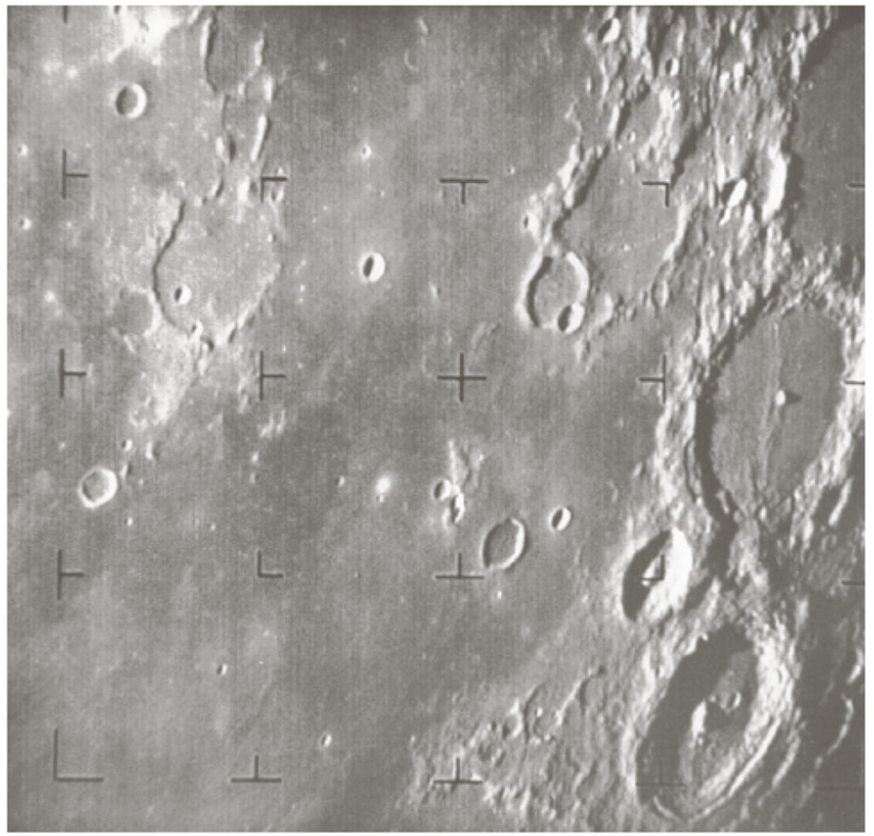
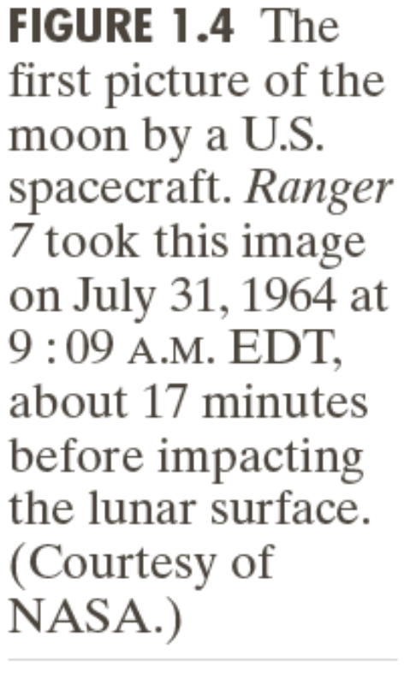
Origins of Digital Image Processing
Weeks 1 & 2

Slide 5
Sources for Images
Electromagnetic (EM) energy spectrum
Acoustic
Ultrasonic
Electronic
Synthetic images produced by computer
Weeks 1 & 2

Slide 6
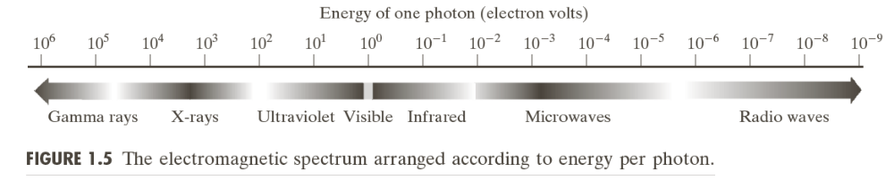
Electromagnetic (EM) energy spectrum
Major uses
Gamma-ray imaging: nuclear medicine and astronomical observations
X-rays: medical diagnostics, industry, and astronomy, etc.
Ultraviolet: lithography, industrial inspection, microscopy, lasers, biological imaging,
and astronomical observations
Visible and infrared bands: light microscopy, astronomy, remote sensing, industry,
and law enforcement
Microwave band: radar
Radio band: medicine (such as MRI) and astronomy
Weeks 1 & 2

Slide 7
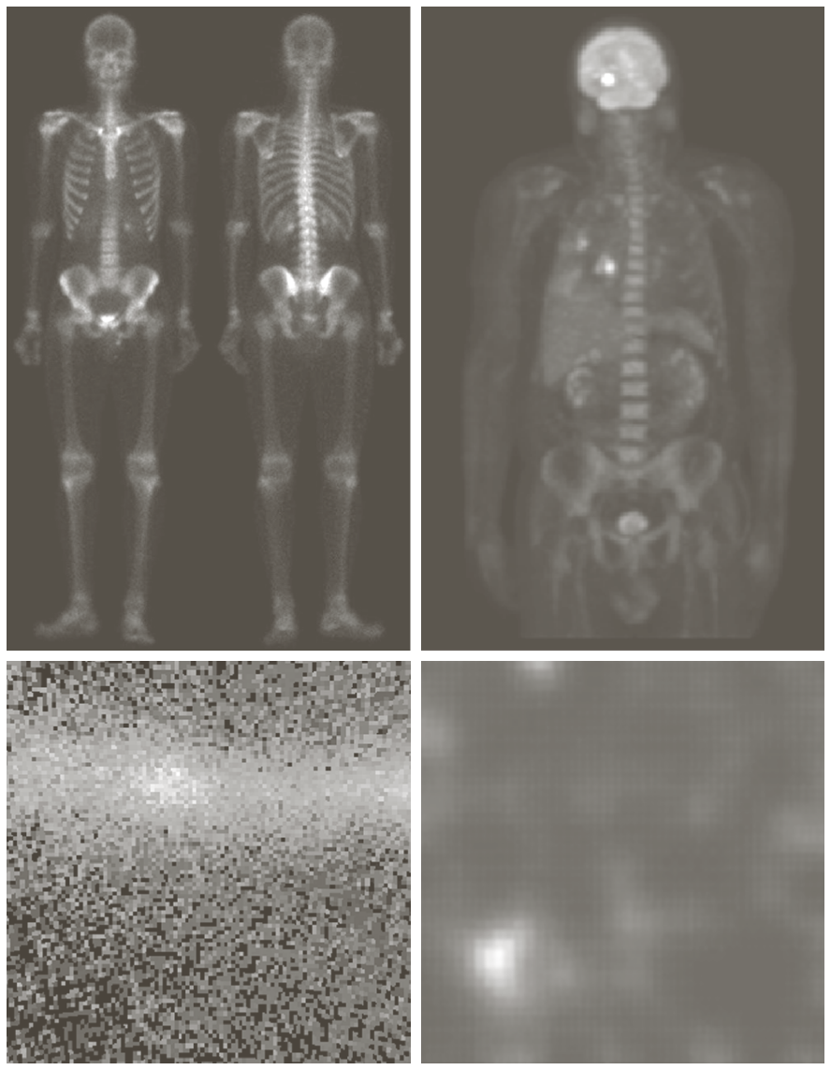
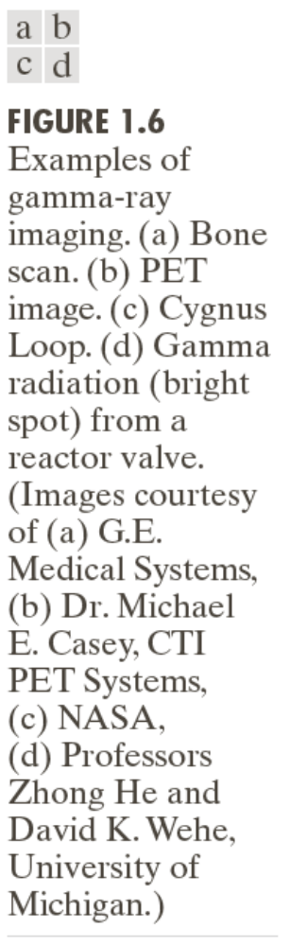
Examples: Gama-Ray Imaging
Weeks 1 & 2

Slide 8
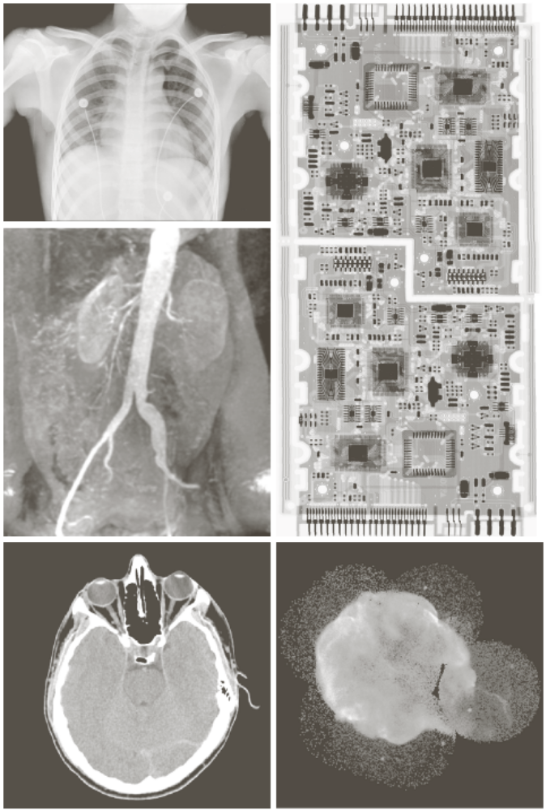
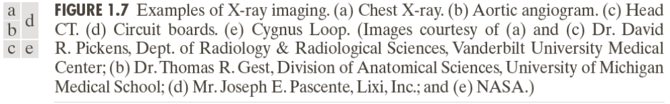
Examples: X-Ray Imaging
Weeks 1 & 2

Slide 9
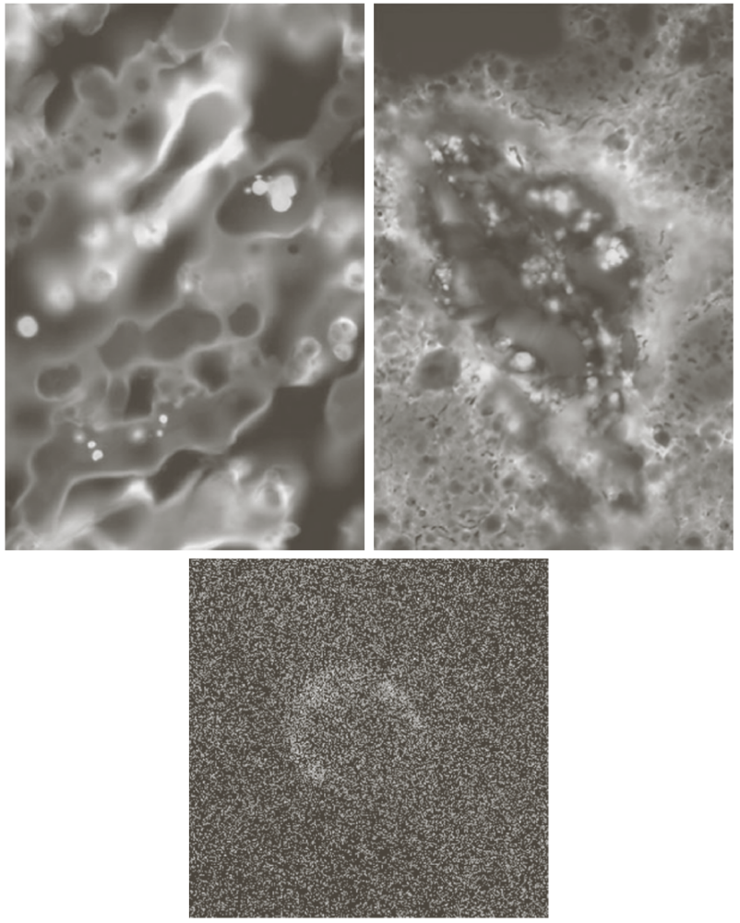
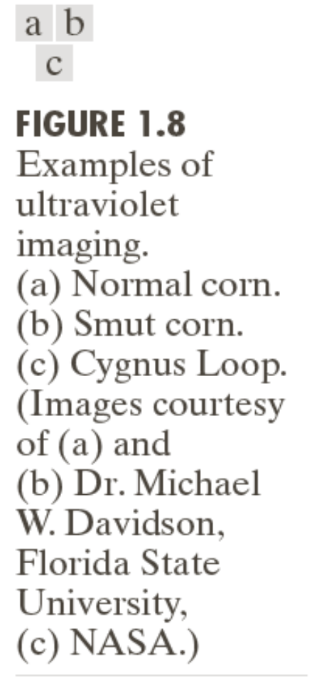
Examples: Ultraviolet Imaging
Weeks 1 & 2

Slide 10
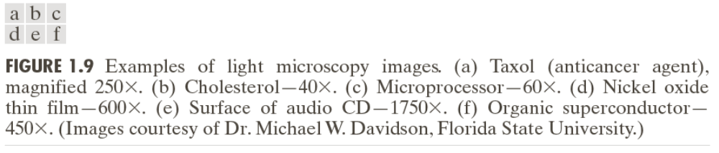
Examples: Light Microscopy Imaging
Weeks 1 & 2

Slide 11
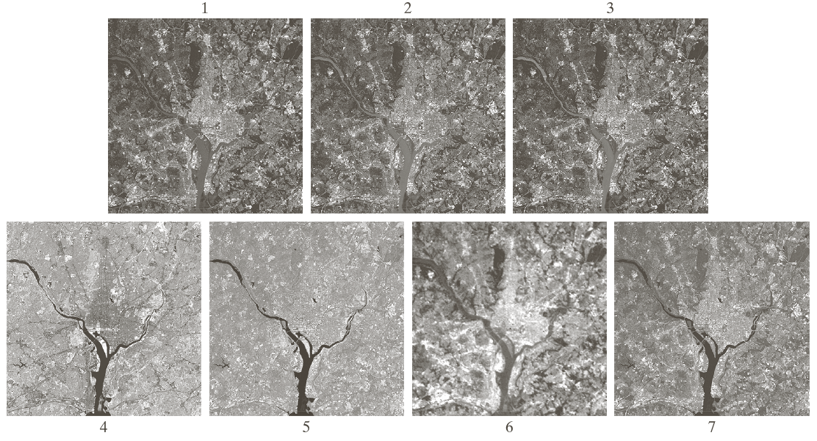
Examples: Visual and Infrared Imaging
Weeks 1 & 2

Slide 12
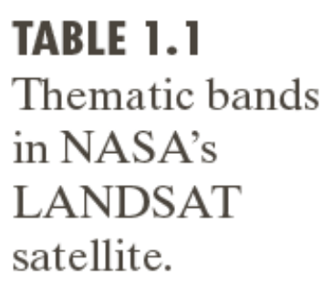
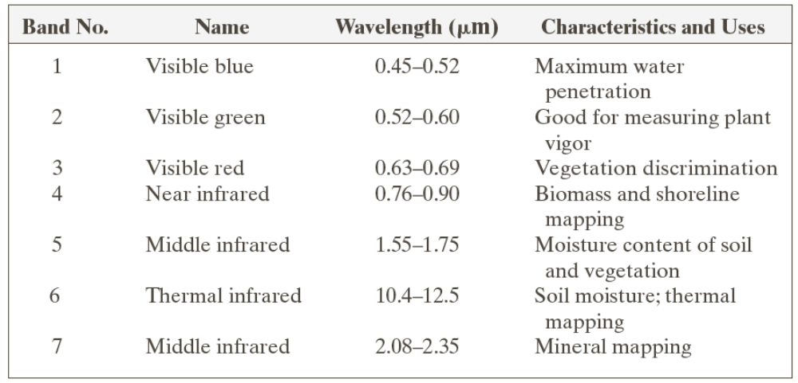
Examples: Visual and Infrared Imaging
Weeks 1 & 2

Slide 13
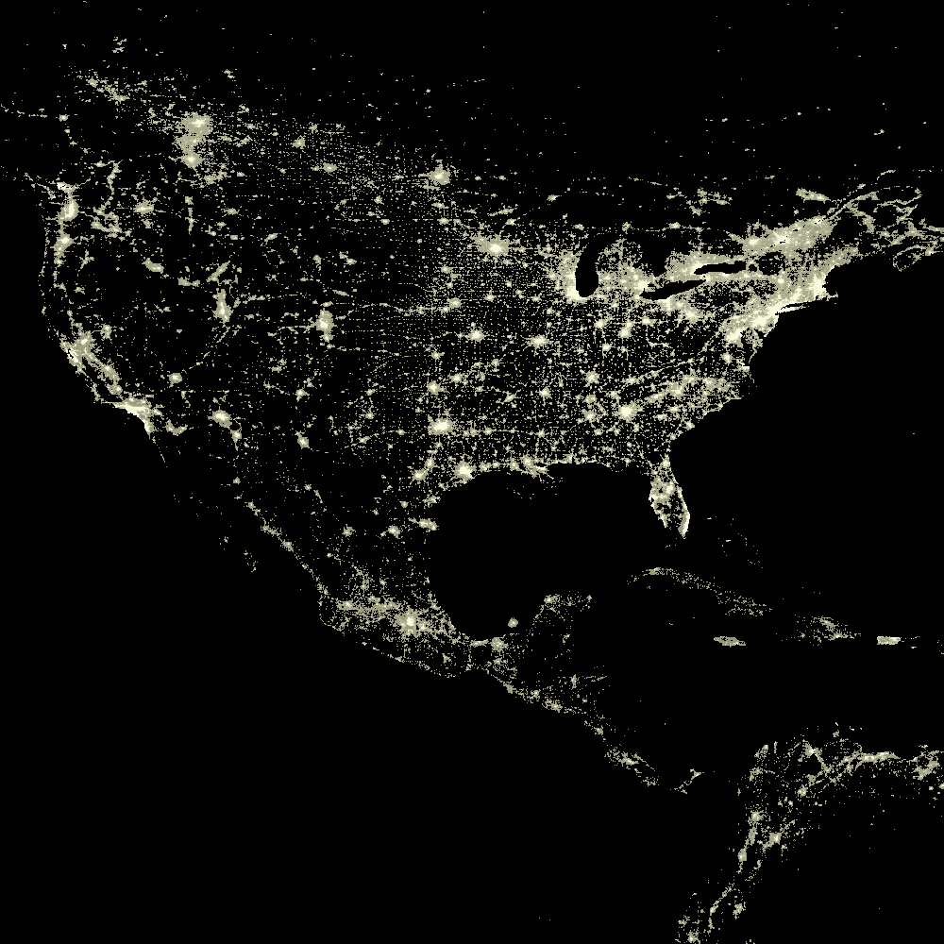
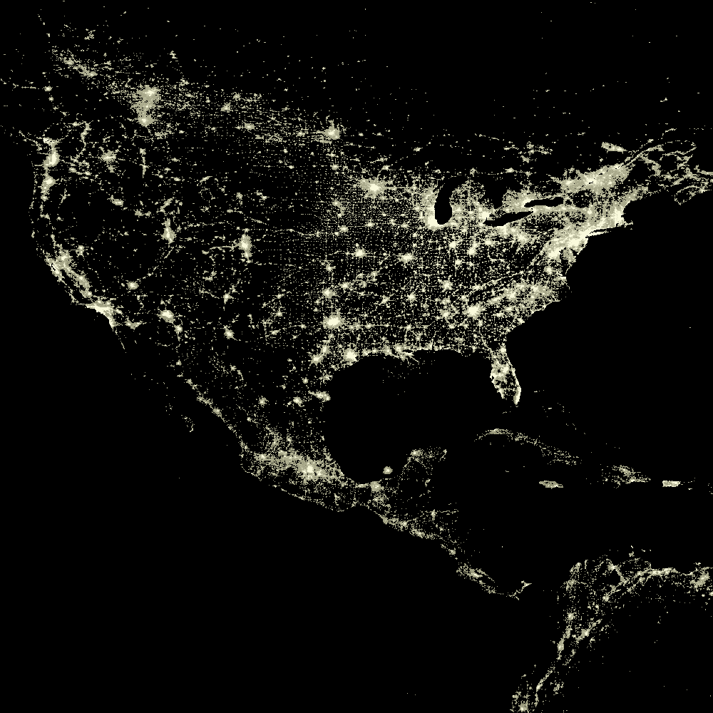
Examples: Infrared Satellite Imaging
USA 2003
USA 1993
Weeks 1 & 2

Slide 14
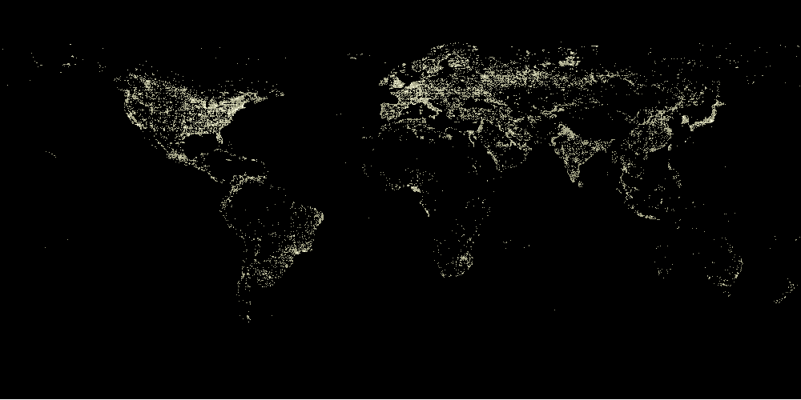
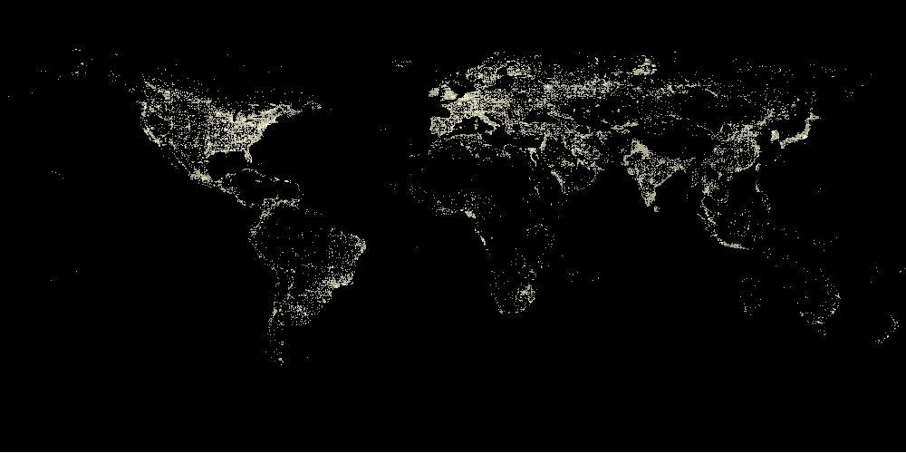
Examples: Infrared Satellite Imaging
Weeks 1 & 2

Slide 15
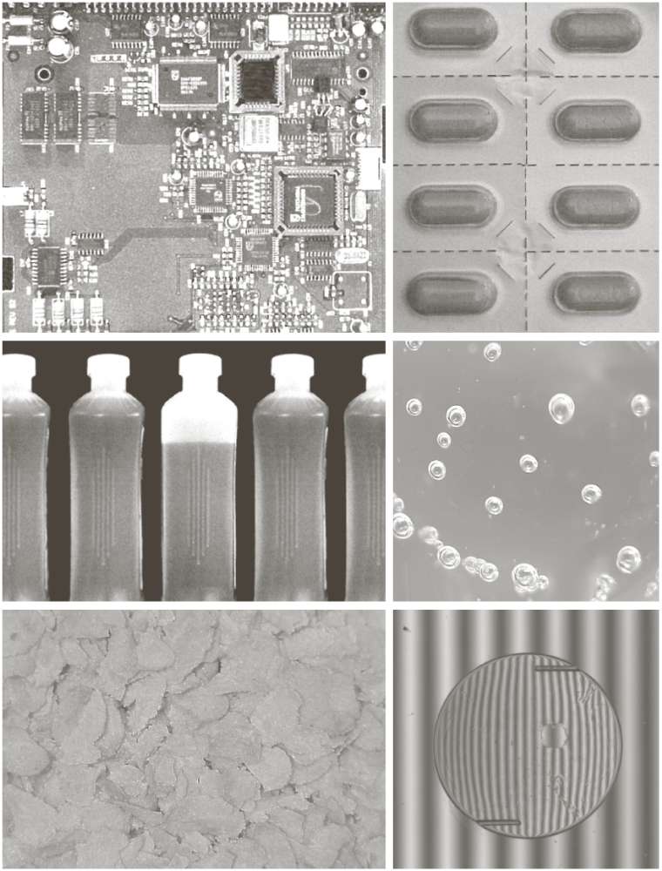
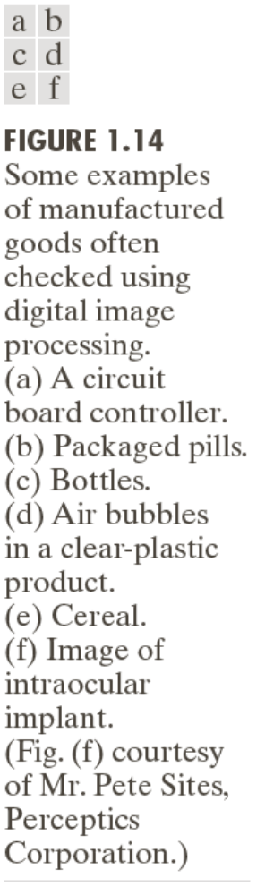
Examples: Automated Visual Inspection
Weeks 1 & 2

Slide 16
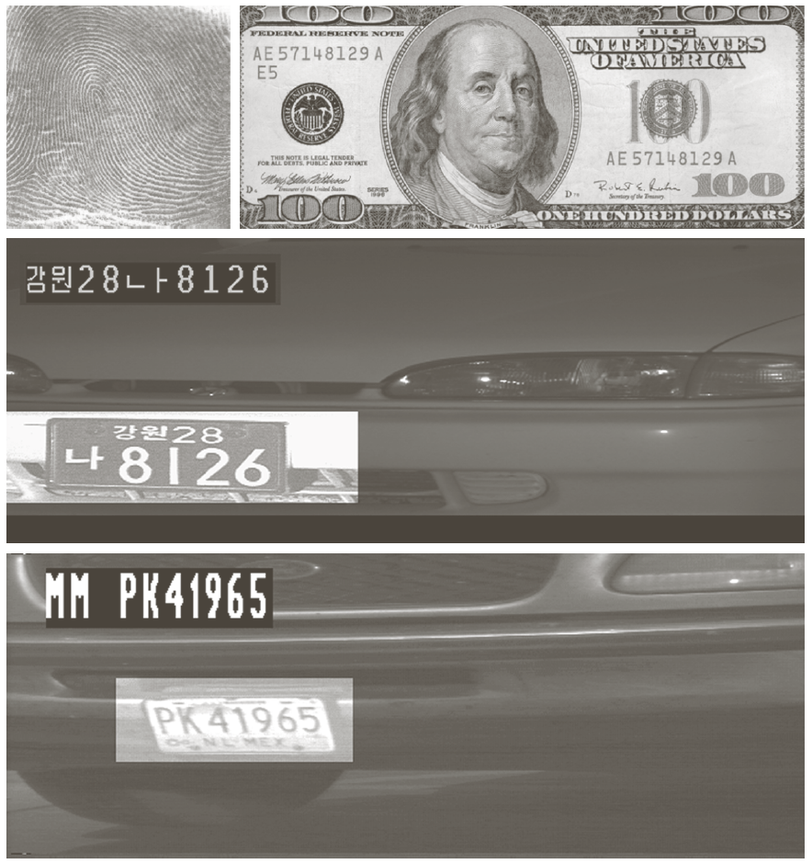
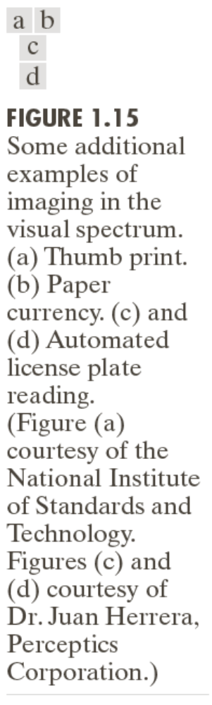
Examples: Automated Visual Inspection
Results of automated reading of the plate content by the system
The area in which the imaging system detected the plate
Weeks 1 & 2

Slide 17
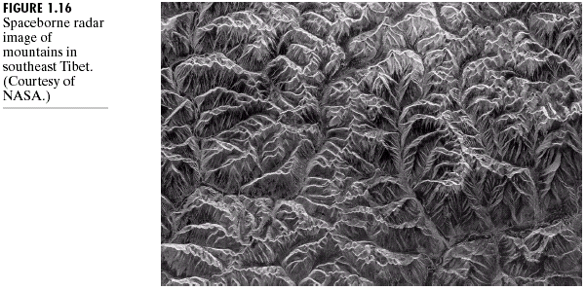
Example of Radar Image
Weeks 1 & 2

Slide 18
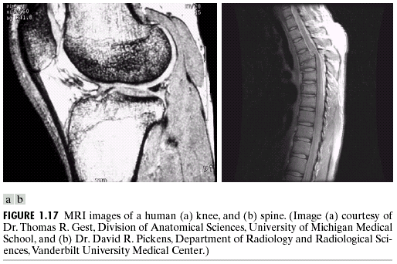
Examples: MRI (Radio Band)
Weeks 1 & 2

Slide 19
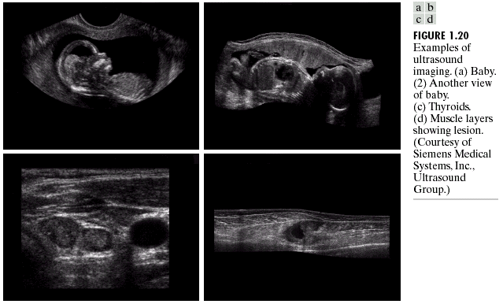
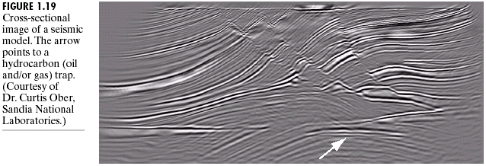
Examples: Ultrasound Imaging
Weeks 1 & 2

Slide 20
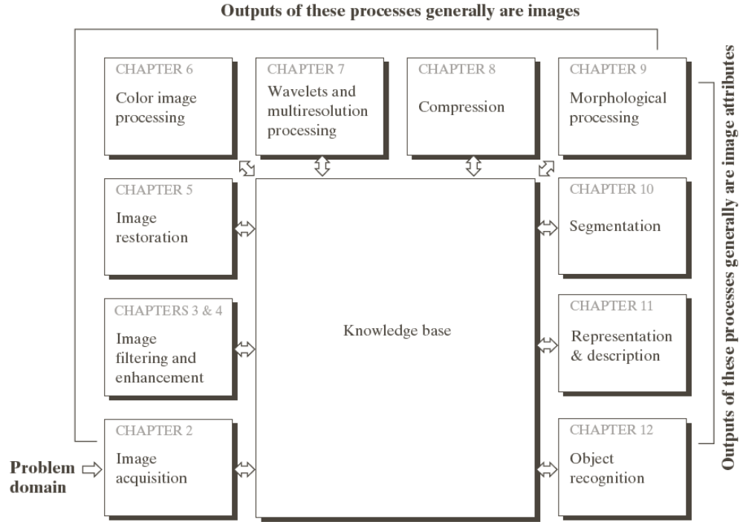
Fundamental Steps in DIP
Extracting image components
Improving the appearance
Partition an image into its constituent parts or objects
Result is more suitable than the original
Represent image for computer processing
Weeks 1 & 2

Slide 21
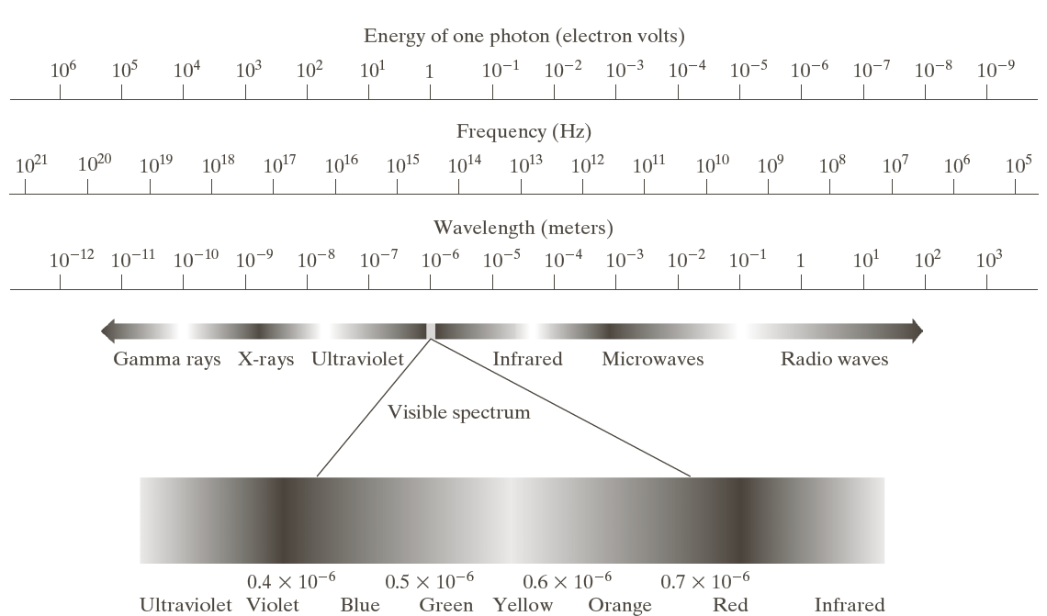
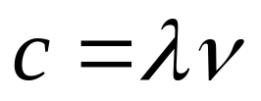

Light and EM Spectrum
Weeks 1 & 2

Slide 22
Light and EM Spectrum
The colors that humans perceive in an object are determined by the nature of the light reflected from the object.
e.g. green objects reflect light with wavelengths primarily in the 500 to 570 nm range while absorbing most of the energy at other wavelength
Weeks 1 & 2

Slide 23
Light and EM Spectrum
Monochromatic light: void of color
Intensity is the only attribute, from black to white
Monochromatic images are referred to as gray-scale images
Chromatic light bands: 0.43 to 0.79 um
The quality of a chromatic light source:
Radiance: total amount of energy
Luminance (lm): the amount of energy an observer perceives from a light source
Brightness: a subjective descriptor of light perception that is impossible to measure. It embodies the achromatic notion of intensity and one of the key factors in describing color sensation.
Weeks 1 & 2

Slide 24
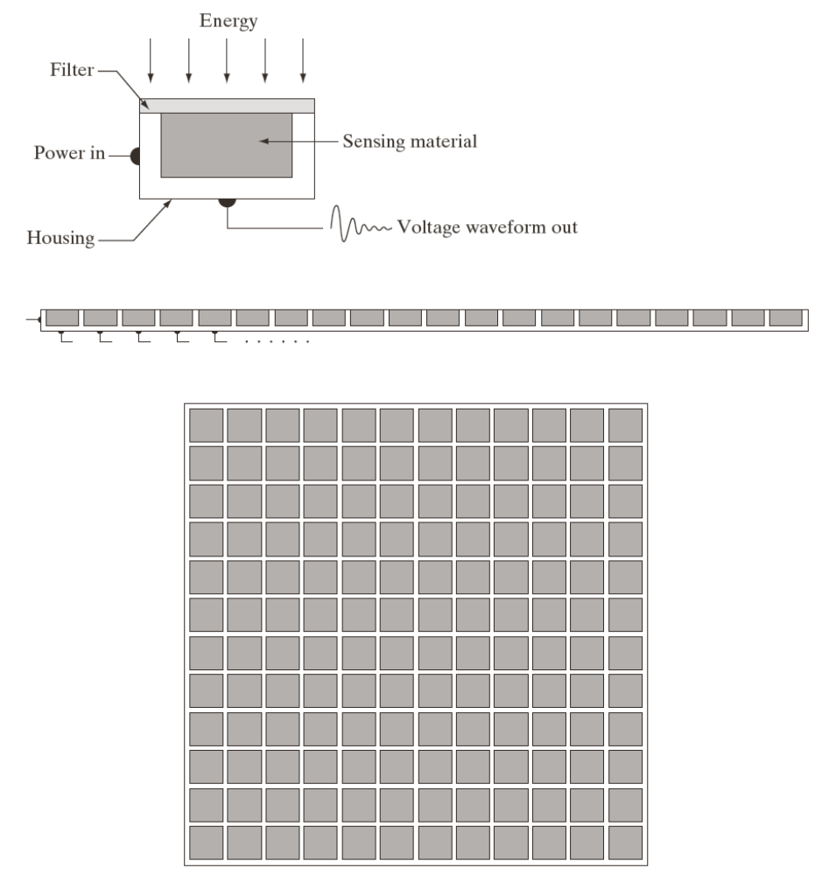
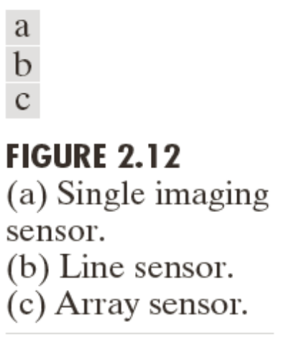
Image Acquisition
Transform illumination energy into digital images
Weeks 1 & 2

Slide 25
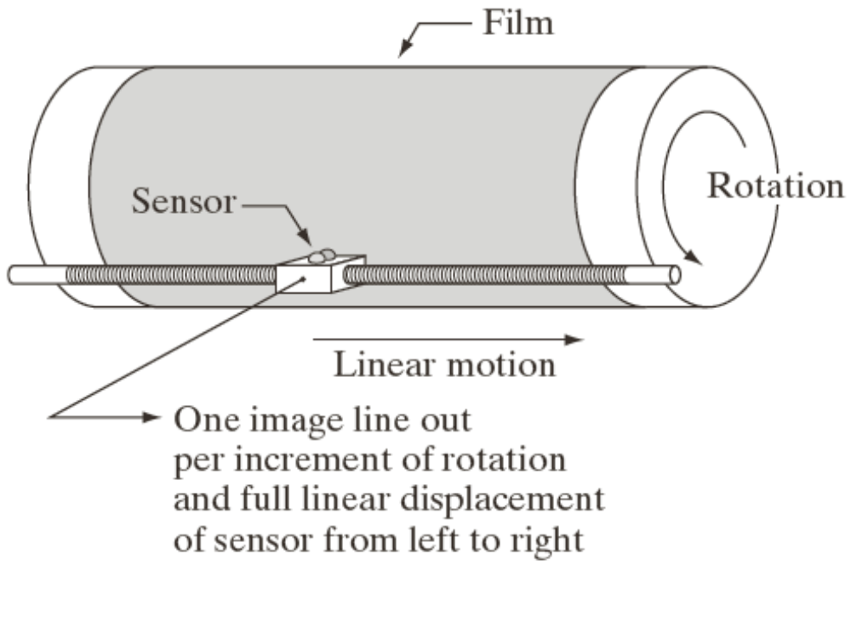
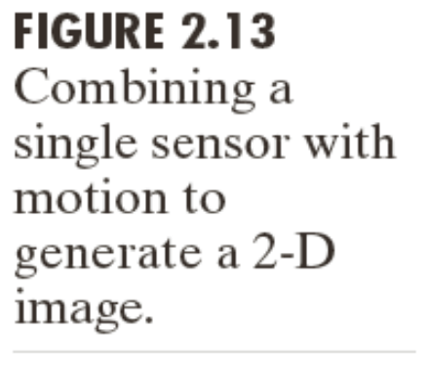
Image Acquisition Using a Single Sensor
Weeks 1 & 2

Slide 26
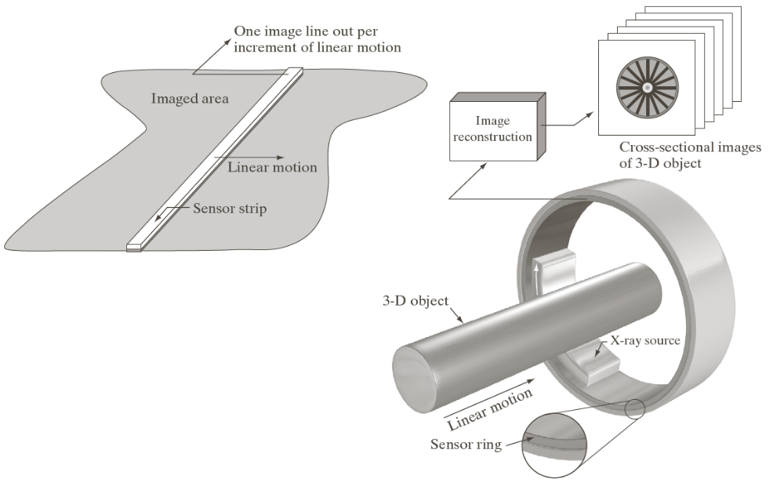
Image Acquisition Using Sensor Strips
Weeks 1 & 2

Slide 27

Image Acquisition Process
Weeks 1 & 2

Slide 28
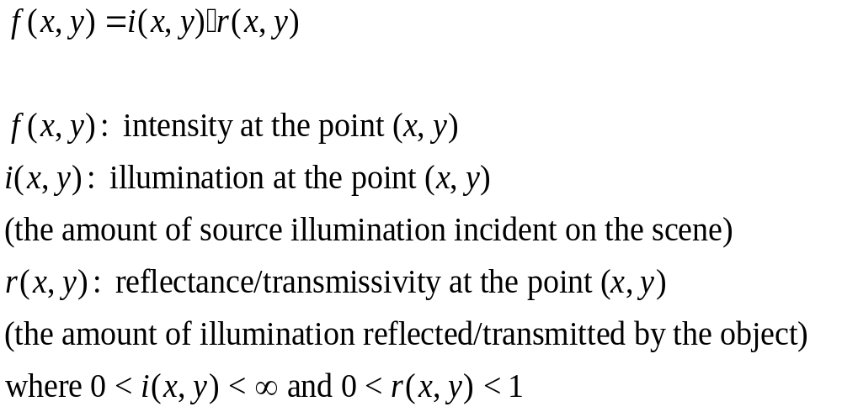
A Simple Image Formation Model
Weeks 1 & 2

Slide 29
Some Typical Ranges of illumination
Illumination
  Lumen — A unit of light flow or luminous flux
  Lumen per square meter (lm/m²) — The metric unit of measure for illuminance of a surface
  On a clear day, the sun may produce in excess of 90,000 lm/m² of illumination on the surface of the Earth
  On a cloudy day, the sun may produce less than 10,000 lm/m² of illumination on the surface of the Earth
  On a clear evening, the moon yields about 0.1 lm/m² of illumination
  The typical illumination level in a commercial office is about 1000 lm/m²
Weeks 1 & 2

Slide 30
Some Typical Ranges of Reflectance
Reflectance
  0.01 for black velvet
  0.65 for stainless steel
  0.80 for flat-white wall paint
  0.90 for silver-plated metal
  0.93 for snow
Weeks 1 & 2

Slide 31
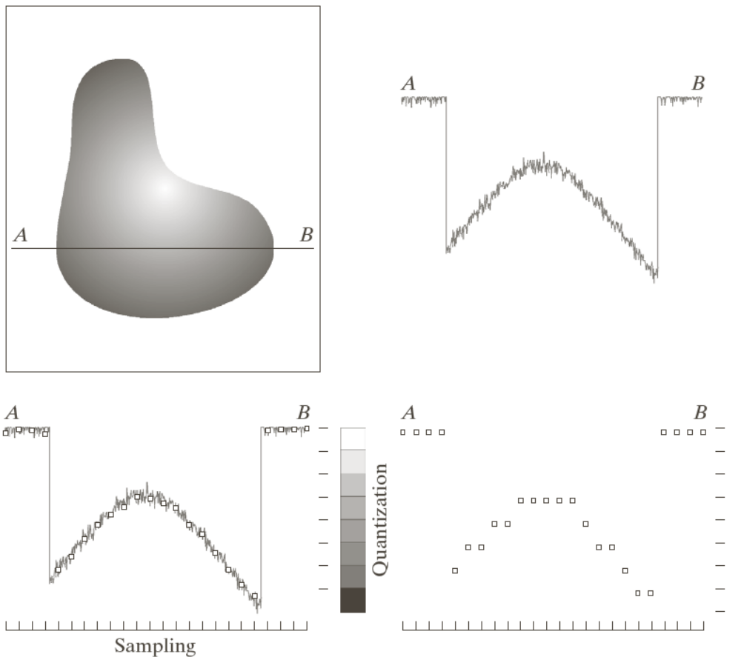
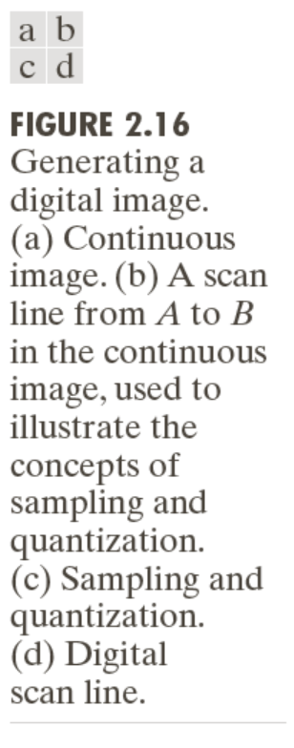
Image Sampling and Quantization
Digitizing the coordinate values
Digitizing the amplitude values
Weeks 1 & 2

Slide 32
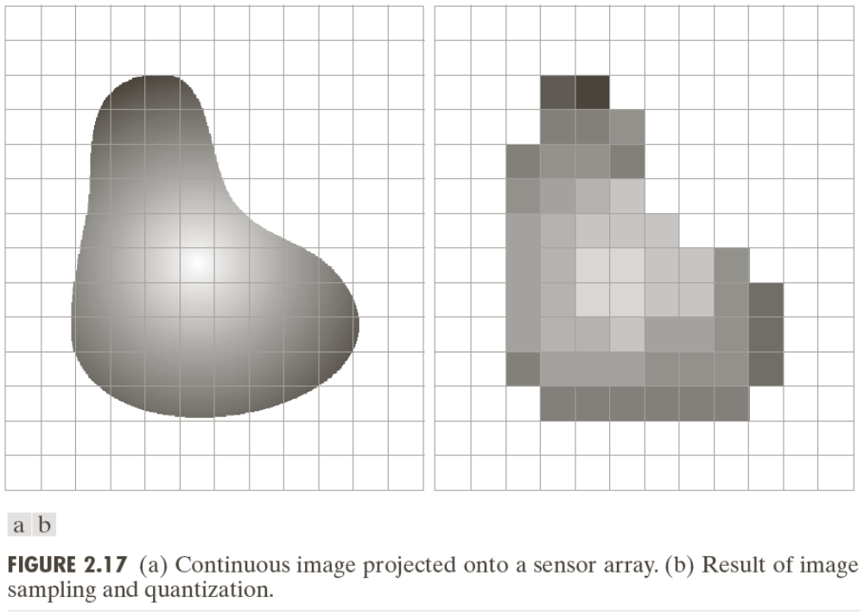
Image Sampling and Quantization
Weeks 1 & 2

Slide 33
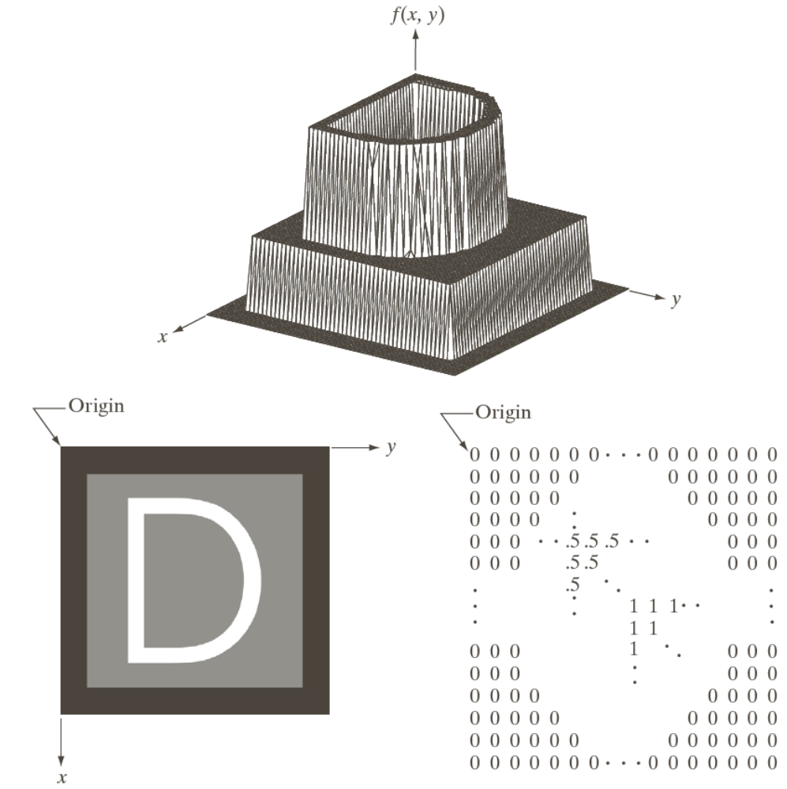
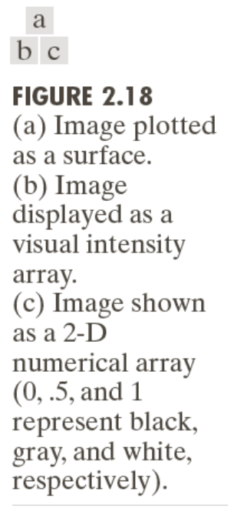
Representing Digital Images
Weeks 1 & 2

Slide 34
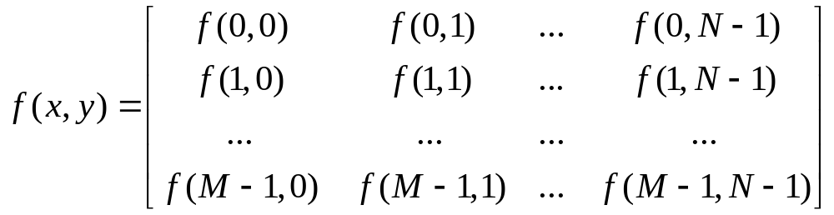
Representing Digital Images
The representation of an M×N numerical array as
Weeks 1 & 2

Slide 35
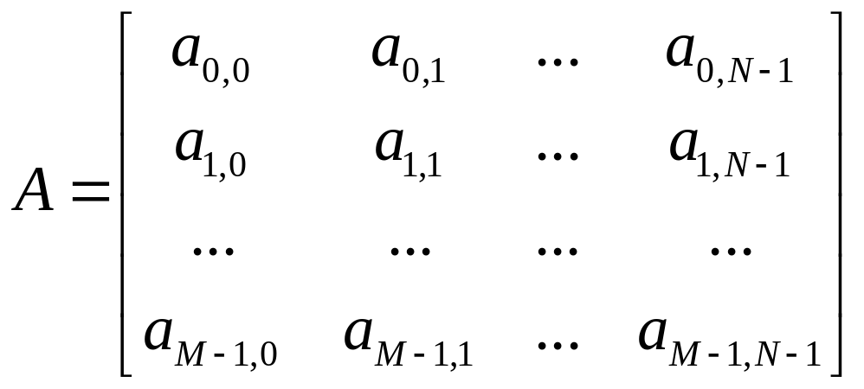
Representing Digital Images
The representation of an M×N numerical array as
Weeks 1 & 2

Slide 36
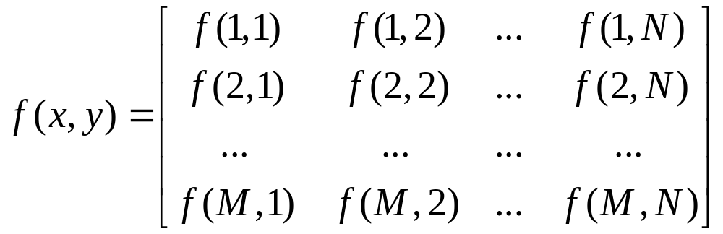
Representing Digital Images
The representation of an M×N numerical array in MATLAB
Weeks 1 & 2

Slide 37
Representing Digital Images
Discrete intensity interval [0, L-1], L=2^{k}
The number b of bits required to store a M × N digitized image
b = M × N × k
Weeks 1 & 2

Slide 38
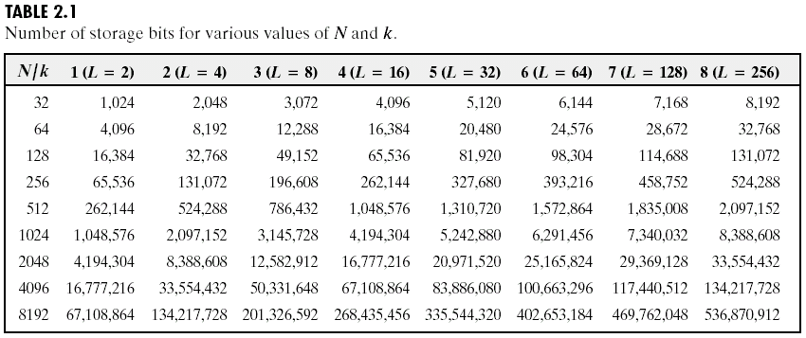
Representing Digital Images
Weeks 1 & 2

Slide 39
Spatial and Intensity Resolution
Spatial resolution
— A measure of the smallest discernible detail in an image
— stated with line pairs per unit distance, dots (pixels) per unit distance, dots per inch (dpi)
Intensity resolution
— The smallest discernible change in intensity level
— stated with 8 bits, 12 bits, 16 bits, etc.
Weeks 1 & 2

Slide 40
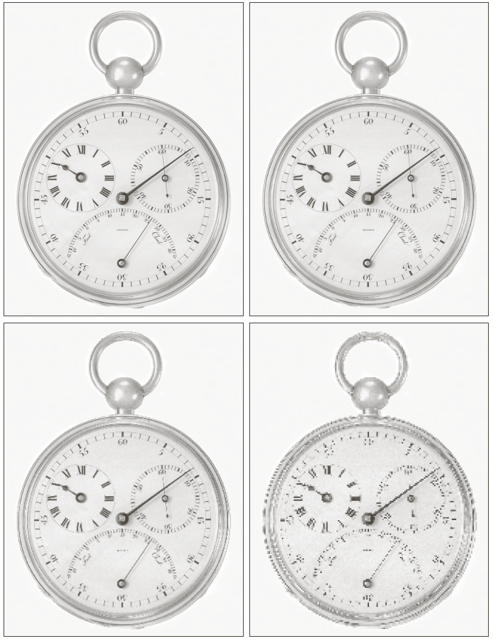
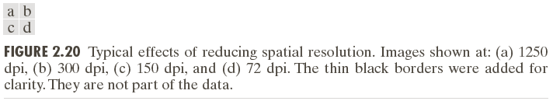
Spatial and Intensity Resolution
Weeks 1 & 2

Slide 41

Spatial and Intensity Resolution
Weeks 1 & 2

Slide 42

Spatial and Intensity Resolution
Weeks 1 & 2

Slide 43
Image Interpolation
Interpolation — Process of using known data to estimate unknown values
e.g., zooming, shrinking, rotating, and geometric correction
Interpolation (sometimes called resampling) — an imaging method to increase (or decrease) the number of pixels in a digital image.
Some digital cameras use interpolation to produce a larger image than the sensor captured or to create digital zoom
http://www.dpreview.com/learn/?/key=interpolation
Weeks 1 & 2

Slide 44
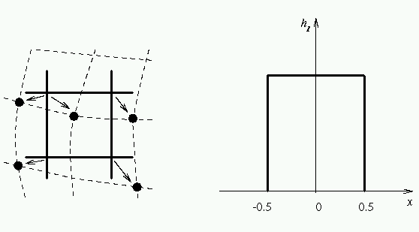
Image Interpolation:
Nearest Neighbor Interpolation
f₁(x₂,y₂) =
f(round(x₂), round(y₂))
=f(x₁,y₁)
f(x₁,y₁)
f₁(x₃,y₃) =
f(round(x₃), round(y₃))
=f(x₁,y₁)
Weeks 1 & 2

Slide 45
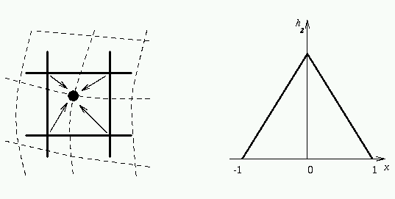
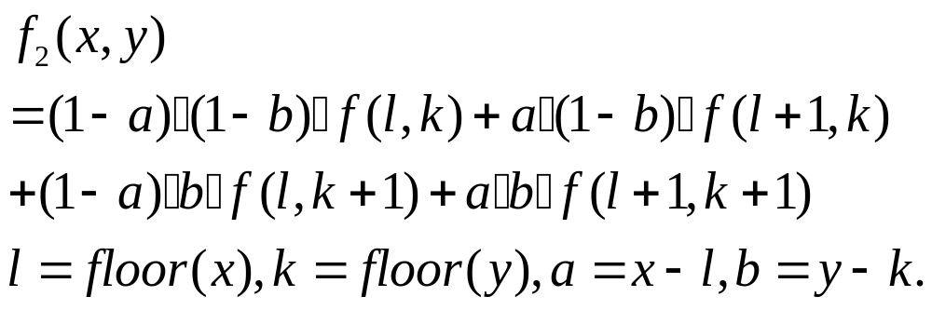
Image Interpolation:
Bilinear Interpolation
(x,y)
Weeks 1 & 2

Slide 46

Image Interpolation:
Bicubic Interpolation
The intensity value assigned to point (x,y) is obtained by the following equation
The sixteen coefficients are determined by using the sixteen nearest neighbors.
http://en.wikipedia.org/wiki/Bicubic_interpolation
Weeks 1 & 2

Slide 47

Examples: Interpolation
Weeks 1 & 2

Slide 48

Examples: Interpolation
Weeks 1 & 2

Slide 49

Examples: Interpolation
Weeks 1 & 2

Slide 50

Examples: Interpolation
Weeks 1 & 2

Slide 51

Examples: Interpolation
Weeks 1 & 2

Slide 52

Examples: Interpolation
Weeks 1 & 2

Slide 53

Examples: Interpolation
Weeks 1 & 2

Slide 54

Examples: Interpolation
Weeks 1 & 2

Slide 55
Basic Relationships Between Pixels
Neighborhood
Adjacency
Connectivity
Paths
Regions and boundaries
Weeks 1 & 2

Slide 56
Basic Relationships Between Pixels
Neighbors of a pixel p at coordinates (x,y)
4-neighbors of p, denoted by N₄(p):
(x-1, y), (x+1, y), (x,y-1), and (x, y+1).
4 diagonal neighbors of p, denoted by N_{D}(p):
(x-1, y-1), (x+1, y+1), (x+1,y-1), and (x-1, y+1).
8 neighbors of p, denoted N₈(p)
N₈(p) = N₄(p) U N_{D}(p)
Weeks 1 & 2

Slide 57
Basic Relationships Between Pixels
Adjacency
Let V be the set of intensity values
4-adjacency: Two pixels p and q with values from V are 4-adjacent if q is in the set N₄(p).
8-adjacency: Two pixels p and q with values from V are 8-adjacent if q is in the set N₈(p).
Weeks 1 & 2

Slide 58
Basic Relationships Between Pixels
Adjacency
Let V be the set of intensity values
m-adjacency: Two pixels p and q with values from V are m-adjacent if
(i) q is in the set N₄(p), or
(ii) q is in the set N_{D}(p) and the set N₄(p) ∩ N₄(p) has no pixels whose values are from V.
Weeks 1 & 2

Slide 59
Basic Relationships Between Pixels
Path
A (digital) path (or curve) from pixel p with coordinates (x₀, y₀) to pixel q with coordinates (x_{n}, y_{n}) is a sequence of distinct pixels with coordinates
(x₀, y₀), (x₁, y₁), …, (x_{n}, y_{n})
Where (x_{i}, y_{i}) and (x_{i-1}, y_{i-1}) are adjacent for 1 ≤ i ≤ n.
Here n is the length of the path.
If (x₀, y₀) = (x_{n}, y_{n}), the path is closed path.
We can define 4-, 8-, and m-paths based on the type of adjacency used.
Weeks 1 & 2

Slide 60
Examples: Adjacency and Path
V = {1, 2}
0 1 1 0 1 1 0 1 1
0 2 0 0 2 0 0 2 0
0 0 1 0 0 1 0 0 1
Weeks 1 & 2

Slide 61
Examples: Adjacency and Path
V = {1, 2}
0 1 1 0 1 1 0 1 1
0 2 0 0 2 0 0 2 0
0 0 1 0 0 1 0 0 1
8-adjacent
Weeks 1 & 2

Slide 62
Examples: Adjacency and Path
V = {1, 2}
0 1 1 0 1 1 0 1 1
0 2 0 0 2 0 0 2 0
0 0 1 0 0 1 0 0 1
8-adjacent
m-adjacent
Weeks 1 & 2

Slide 63
Examples: Adjacency and Path
V = {1, 2}
01,1 11,2 11,3 0 1 1 0 1 1
02,1 22,2 02,3 0 2 0 0 2 0
03,1 03,2 13,3 0 0 1 0 0 1
8-adjacent
m-adjacent
The 8-path from (1,3) to (3,3):
(1,3), (1,2), (2,2), (3,3)
(1,3), (2,2), (3,3)
The m-path from (1,3) to (3,3):
(1,3), (1,2), (2,2), (3,3)
Weeks 1 & 2

Slide 64

Basic Relationships Between Pixels
Connected in S
Let S represent a subset of pixels in an image. Two pixels p with coordinates (x₀, y₀) and q with coordinates (x_{n}, y_{n}) are said to be connected in S if there exists a path
(x₀, y₀), (x₁, y₁), …, (x_{n}, y_{n})
Where
Weeks 1 & 2

Slide 65
Basic Relationships Between Pixels
Let S represent a subset of pixels in an image
For every pixel p in S, the set of pixels in S that are connected to p is called a connected component of S.
If S has only one connected component, then S is called Connected Set.
We call R a region of the image if R is a connected set
Two regions, R_{i} and R_{j} are said to be adjacent if their union forms a connected set.
Regions that are not to be adjacent are said to be disjoint.
Weeks 1 & 2

Slide 66
Basic Relationships Between Pixels
Boundary (or border)
The boundary of the region R is the set of pixels in the region that have one or more neighbors that are not in R.
If R happens to be an entire image, then its boundary is defined as the set of pixels in the first and last rows and columns of the image.
Foreground and background
An image contains K disjoint regions, R_{k}, k = 1, 2, …, K. Let R_{u} denote the union of all the K regions, and let (R_{u})^{c} denote its complement.
All the points in R_{u} is called foreground;
All the points in (R_{u})^{c} is called background.
Weeks 1 & 2

Slide 67
Question 1
In the following arrangement of pixels, are the two regions (of 1s) adjacent? (if 8-adjacency is used)
1 1 1
1 0 1
0 1 0
0 0 1
1 1 1
1 1 1
Region 1
Region 2
Weeks 1 & 2

Slide 68
Question 2
In the following arrangement of pixels, are the two parts (of 1s) adjacent? (if 4-adjacency is used)
1 1 1
1 0 1
0 1 0
0 0 1
1 1 1
1 1 1
Part 1
Part 2
Weeks 1 & 2

Slide 69
In the following arrangement of pixels, the two regions (of 1s) are disjoint (if 4-adjacency is used)
1 1 1
1 0 1
0 1 0
0 0 1
1 1 1
1 1 1
Region 1
Region 2
Weeks 1 & 2

Slide 70
In the following arrangement of pixels, the two regions (of 1s) are disjoint (if 4-adjacency is used)
1 1 1
1 0 1
0 1 0
0 0 1
1 1 1
1 1 1
foreground
background
Weeks 1 & 2

Slide 71
Question 3
In the following arrangement of pixels, the circled point is part of the boundary of the 1-valued pixels if 8-adjacency is used, true or false?
0 0 0 0 0
0 1 1 0 0
0 1 1 0 0
0 1 1 1 0
0 1 1 1 0
0 0 0 0 0
Weeks 1 & 2

Slide 72
Question 4
In the following arrangement of pixels, the circled point is part of the boundary of the 1-valued pixels if 4-adjacency is used, true or false?
0 0 0 0 0
0 1 1 0 0
0 1 1 0 0
0 1 1 1 0
0 1 1 1 0
0 0 0 0 0
Weeks 1 & 2

Slide 73
Distance Measures
Given pixels p, q and z with coordinates (x, y), (s, t), (u, v) respectively, the distance function D has following properties:
D(p, q) ≥ 0 [D(p, q) = 0, iff p = q]
D(p, q) = D(q, p)
D(p, z) ≤ D(p, q) + D(q, z)
Weeks 1 & 2

Slide 74


Distance Measures
The following are the different Distance measures:
a. Euclidean Distance :
D_{e}(p, q) = [(x-s)² + (y-t)²]^{1/2}
b. City Block Distance:
D₄(p, q) = |x-s| + |y-t|
c. Chess Board Distance:
D₈(p, q) = max(|x-s|, |y-t|)
Weeks 1 & 2

Slide 75
Question 5
In the following arrangement of pixels, what’s the value of the chessboard distance between the circled two points?
0 0 0 0 0
0 0 1 1 0
0 1 1 0 0
0 1 0 0 0
0 0 0 0 0
0 0 0 0 0
Weeks 1 & 2

Slide 76
Question 6
In the following arrangement of pixels, what’s the value of the city-block distance between the circled two points?
0 0 0 0 0
0 0 1 1 0
0 1 1 0 0
0 1 0 0 0
0 0 0 0 0
0 0 0 0 0
Weeks 1 & 2

Slide 77
Question 7
In the following arrangement of pixels, what’s the value of the length of the m-path between the circled two points?
0 0 0 0 0
0 0 1 1 0
0 1 1 0 0
0 1 0 0 0
0 0 0 0 0
0 0 0 0 0
Weeks 1 & 2

Slide 78
Question 8
In the following arrangement of pixels, what’s the value of the length of the m-path between the circled two points?
0 0 0 0 0
0 0 1 1 0
0 0 1 0 0
0 1 0 0 0
0 0 0 0 0
0 0 0 0 0
Weeks 1 & 2

Slide 79




Introduction to Mathematical Operations in DIP
Array vs. Matrix Operation
Array product
operator
Array product
Matrix product
operator
Matrix product
Weeks 1 & 2

Slide 80


Introduction to Mathematical Operations in DIP
Linear vs. Nonlinear Operation
H is said to be a linear operator;
H is said to be a nonlinear operator if it does not meet the above qualification.
Additivity
Homogeneity
Weeks 1 & 2

Slide 81
Arithmetic Operations
Arithmetic operations between images are array operations. The four arithmetic operations are denoted as
s(x,y) = f(x,y) + g(x,y)
d(x,y) = f(x,y) – g(x,y)
p(x,y) = f(x,y) × g(x,y)
v(x,y) = f(x,y) ÷ g(x,y)
Weeks 1 & 2

Slide 82

Example: Addition of Noisy Images for Noise Reduction
Noiseless image: f(x,y)
Noise: n(x,y) (at every pair of coordinates (x,y), the noise is uncorrelated and has zero average value)
Corrupted image: g(x,y)
g(x,y) = f(x,y) + n(x,y)
Reducing the noise by adding a set of noisy images, {g_{i}(x,y)}
Weeks 1 & 2

Slide 83


Example: Addition of Noisy Images for Noise Reduction
Weeks 1 & 2

Slide 84
Example: Addition of Noisy Images for Noise Reduction
In astronomy, imaging under very low light levels frequently causes sensor noise to render single images virtually useless for analysis.
In astronomical observations, similar sensors for noise reduction by observing the same scene over long periods of time. Image averaging is then used to reduce the noise.
Weeks 1 & 2

Slide 85

Weeks 1 & 2

Slide 86
An Example of Image Subtraction: Mask Mode Radiography
Mask h(x,y): an X-ray image of a region of a patient’s body
Live images f(x,y): X-ray images captured at TV rates after injection of the contrast medium
Enhanced detail g(x,y)
g(x,y) = f(x,y) - h(x,y)
The procedure gives a movie showing how the contrast medium propagates through the various arteries in the area being observed.
Weeks 1 & 2

Slide 87


Weeks 1 & 2

Slide 88

An Example of Image Multiplication
Weeks 1 & 2

Slide 89


Set and Logical Operations
Weeks 1 & 2

Slide 90


Set and Logical Operations
Let A be the elements of a gray-scale image
The elements of A are triplets of the form (x, y, z), where x and y are spatial coordinates and z denotes the intensity at the point (x, y).
The complement of A is denoted A^{c}
Weeks 1 & 2

Slide 91

Set and Logical Operations
The union of two gray-scale images (sets) A and B is defined as the set
Weeks 1 & 2

Slide 92


Set and Logical Operations
Weeks 1 & 2

Slide 93


Set and Logical Operations
Weeks 1 & 2

Slide 94



Spatial Operations
Single-pixel operations
Alter the values of an image’s pixels based on the intensity.
e.g.,
Weeks 1 & 2

Slide 95

Spatial Operations
Neighborhood operations
The value of this pixel is determined by a specified operation involving the pixels in the input image with coordinates in S_{xy}
Weeks 1 & 2

Slide 96
Spatial Operations
Neighborhood operations
Weeks 1 & 2

Slide 97


Geometric Spatial Transformations
Geometric transformation (rubber-sheet transformation)
— A spatial transformation of coordinates
— intensity interpolation that assigns intensity values to the spatially transformed pixels.
Affine transform
Weeks 1 & 2

Slide 98

Weeks 1 & 2

Slide 99

Intensity Assignment
Forward Mapping
It’s possible that two or more pixels can be transformed to the same location in the output image.
Inverse Mapping
The nearest input pixels to determine the intensity of the output pixel value.
Inverse mappings are more efficient to implement than forward mappings.
Weeks 1 & 2

Slide 100

Example: Image Rotation and Intensity Interpolation
Weeks 1 & 2

Slide 101
Image Registration
Input and output images are available but the transformation function is unknown.
Goal: estimate the transformation function and use it to register the two images.
One of the principal approaches for image registration is to use tie points (also called control points)
The corresponding points are known precisely in the input and output (reference) images.
Weeks 1 & 2

Slide 102

Image Registration
A simple model based on bilinear approximation:
Weeks 1 & 2

Slide 103
Image Registration
Weeks 1 & 2

Slide 104

Image Transform
A particularly important class of 2-D linear transforms, denoted T(u, v)
Weeks 1 & 2

Slide 105

Image Transform
Given T(u, v), the original image f(x, y) can be recoverd using the inverse tranformation of T(u, v).
Weeks 1 & 2

Slide 106


Image Transform
Weeks 1 & 2

Slide 107


Example: Image Denoising by Using DCT Transform
Weeks 1 & 2

Slide 108

Forward Transform Kernel
Weeks 1 & 2

Slide 109

The Kernels for 2-D Fourier Transform
Weeks 1 & 2

Slide 110

2-D Fourier Transform
Weeks 1 & 2

Slide 111



Probabilistic Methods
Weeks 1 & 2

Slide 112


Probabilistic Methods
Weeks 1 & 2

Slide 113




Example: Comparison of Standard Deviation Values
Weeks 1 & 2

Slide 114
Homework
http://cramer.cs.nmt.edu/~ip/assignments.html
Weeks 1 & 2

